Slide 1
Apex Company
Sara Ricchiuti
2nd November 2022

Slide 2
Agenda
01. Introduction
02. ER diagram
03. Total orders per customers
04. Employees vs orders per each store
05. Closing
.

Slide 3

Introduction
Data analysis of Apex database with the purpose of:
Targeting a niche of customers and improve marketing strategies.
Evaluate if a change on number of employees in store is necessary to improve the operation and profit.

Slide 4
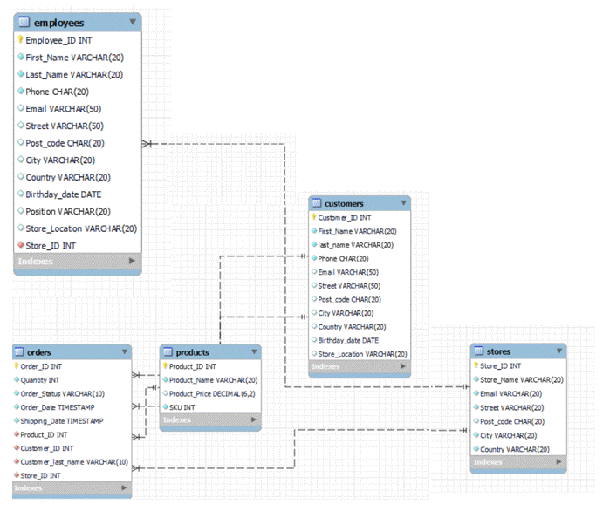
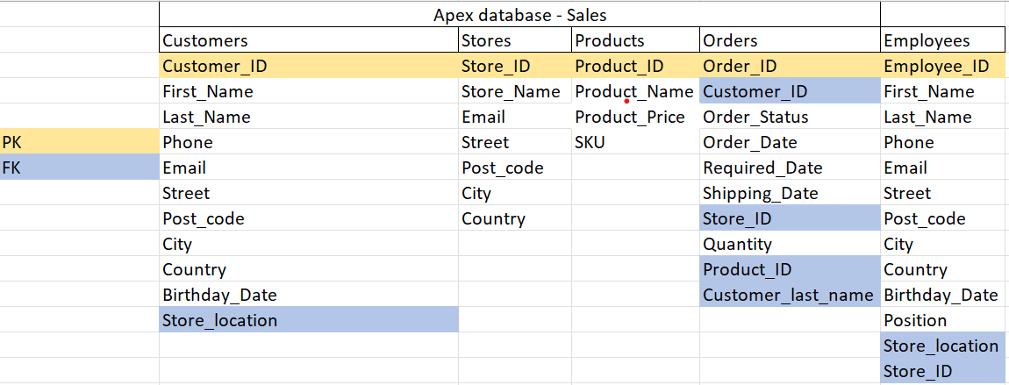
ER diagram for Apex database

Slide 5
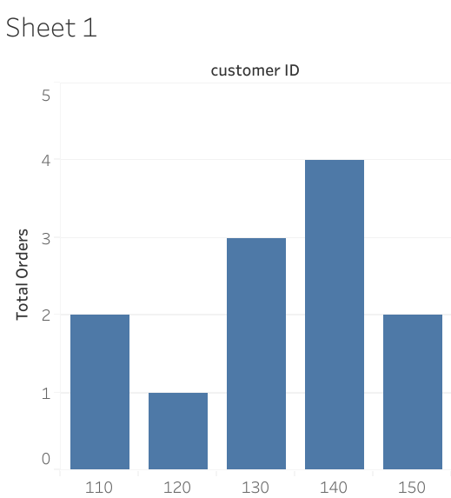
Total orders per customers
The graph shows the total orders of a certain number of customers. Such analysis aims to implement a loyalty scheme to reward best-spending customers.

Slide 6
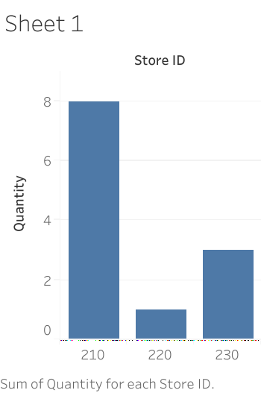
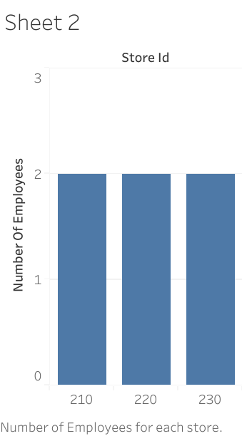
Employees vs orders per each store
The two graphs represent the comparison between orders made in each store (sheet 1) against employees working at the in store (sheet 2).
From this analysis it is clear where a change on the workforce must be made to improve the operation and the productivity of the store with more orders. As well as amending the number of employees where the business is lower in order to cut costs.

Slide 7

Thank you

